Slide 1
IDENTIFYING FRAUDULENT ACTIVITY IN BLOCKCHAIN TRANSACTIONS USING MACHINE LEARNING ALGORITHMS
CAPSTONE PROJECT PRESENTATION
SUPERVISOR: MR. DHASON PADMAKUMAR
2ND MARKER: MS. CHONG MIEN MAY
STUDENT NAME: TEOH KHENG HONG
STUDENT TP NO.: TP030562
INTAKE: APDMP2201DSBA (DE)(PR)

Slide 2
Agenda
1
2
3
4
5
Introduction
Literature Review
Project Methodology
Implementation
Results & Discussion

Slide 3

Introduction
Blockchain is acknowledged as a groundbreaking method for transaction execution.
Originating from a white paper by Satoshi in 2008, it introduced a decentralized peer-to-peer electronic cash system.
Blockchain technology extends beyond transactions to various applications based on specific requirements.

Slide 4
Applications
Finance
Cryptocurrencies,
Non-Fungible Tokens (NFTs)
Healthcare
Electronic Health Records
Mobile
Digital assets
Decentralized Finance (DeFi) mobile apps
Internet of Things (IoT)
Better data exchange between devices with limited resources (Tran, N. K. , Babar, M. A. , Boan, J. , 2020).
Supply Chain
Secure validation of material and supply flow from faulty product (Ahmad et al., 2022)

Slide 5
Current Context
Over 24,000 cryptocurrencies
Trading over 600 exchanges
Capitalization exceeds $1 trillion (CoinMarketCap, 2024)
More than 60% of blockchain worldwide market value comes from financial sector (Petrov, 2023).
Adoption of blockchain in financial transactions are increasing
Cost of transaction using blockchain are cheaper than transaction costs in the traditional economy, as it reduces security, auditing, 3rd party safeguarding and other related risks (Schmidt & Wagner, 2019).
Reduce banks’ infrastructure costs up to 30 % (Warren & Treat, 2019).
IDENTIFYING FRAUDULENT ACTIVITY IN BLOCKCHAIN TRANSACTIONS USING MACHINE LEARNING ALGORITHMS

Slide 6
Problem Statement
Existing methods of fraud detection yet to cover neural networks in Ethereum blockchain transaction with the research of
No full detailed work is provided by many researchers to show exact instructions, difficult to reproduce.
Contribution to the research on the compiled dataset given by Farrugia et al. (2020) with other researchers.
Discover the effectiveness of neural networks in fraud detection techniques on the compiled dataset.

Slide 7
Project Questions
What patterns in blockchain transactions that can indicate fraudulent activity?
How machine learning models detect and flag suspicious transactions in blockchain data accurately?
Which machine learning algorithm are the most effective for identifying fraudulent activity in blockchain transactions?

Slide 8
Aim
To propose effective method to detect illicit blockchain accounts through transaction history data and develop models that can detect and flag suspicious transactions using machine learning algorithms.

Slide 9
Objectives
To identify features of blockchain transaction of the accounts that may indicate fraudulent activity from the blockchain transaction data.
To develop models that can automatically detect and flag suspicious transactions using machine learning techniques.
To ensure the model can detect fraudulent activity effectively and efficiently by evaluating the performance of the implemented models.

Slide 10
Project Scope
Data Collection and Pre-processing:
Collect and preprocess blockchain transaction data, focusing on the dataset provided by Farrugia et al. (2020).
Explore and analyze the data to identify patterns and anomalies, ensuring suitability for fraud detection tasks.
Machine Learning Techniques:
Select and implement appropriate machine learning techniques for fraud detection.
Finalize one to two ML techniques for building the fraud detection model.
Consider using XGBoost as the primary algorithm along with proposed techniques such as DNN, based on analysis of research papers.
Model Building Process:
Describe the data preparation, hyperparameter tuning, and visualization steps involved in the model building process.
Utilize various libraries and IDEs available for efficient modeling.
Performance Evaluation:
Evaluate the performance of the model against existing fraud detection algorithms.
Measure accuracy, precision, recall, and F1 score of the model.
Compare the model's performance to baseline methods to assess its efficacy.
Project Outcome and Relevance:
Provide insights and results that could be useful for other researchers in the field of fraud detection.
Contribute to the advancement of fraud detection methodologies in blockchain networks.
Enhance understanding of the applicability and effectiveness of machine learning techniques in detecting fraudulent activities.
Notes:
What will the data scientist will be doing on the capstone project.

Slide 11
Significance of the Study
Data Source and Code Repository:
Utilize data sources and code repositories from previous research papers to build upon existing foundations.
Leverage Ethereum transaction data from reputable blockchain inquiry websites such as etherscan.io.
Unique Characteristics of Blockchain:
Highlight the limitations of traditional manual fraud detection methods in the context of blockchain transactions.
Emphasize the potential of machine learning algorithms to address these challenges by identifying complex patterns and anomalies.
Improving Fraud Detection:
Aim to enhance the accuracy and efficiency of fraud detection in blockchain transactions.
Potentially reduce the incidence of financial crimes in the blockchain ecosystem.
Promoting Trust and Adoption:
Improve trust and confidence of users in blockchain technology by enhancing fraud detection capabilities.
Promote adoption of blockchain technology across various industries by mitigating risks associated with fraudulent activities.
Contribution to Research:
Contribute to broader research on the application of machine learning techniques to blockchain technology.
Explore emerging fields such as deep learning algorithms in the context of Ethereum transaction networks.
Informing Future Research:
Provide insights and results that can inform future research and development in fraud detection on blockchain networks.
Contribute to the advancement of knowledge and methodologies in the field of blockchain security and machine learning.

Slide 12

Research Background

Slide 13

Blockchain

Slide 14
Blockchain Network
Public Blockchain:
Fully embraces decentralization.
Open to anyone without restrictions.
Transactions are anonymous.
Promotes trust and security through community review.
Drawbacks include slower processing, high energy consumption, and government reluctance.
Private Blockchain:
Designed for use within a single organization.
Offers more control over the network.
Faster and more efficient than public blockchains.
Less transparent and may lack security due to centralized control.
Consortium Blockchain:
Also known as federated blockchain.
Falls between public and private models.
Permissioned network shared by multiple organizations.
Suitable for industries requiring collaboration and trust.
Examples include Hyperledger Fabric, used in supply chain, healthcare, and finance.

Slide 15
Comparison
Aspect | Public Blockchain | Private Blockchain | Consortium Blockchain
Decentralization | Fully decentralized | Centralized within organization | Shared responsibility among entities
Participation | Anyone can join and contribute | Restricted participation | Multiple organizations involved
Transparency | Transactions are entirely anonymous | More control over network and data | Defined rules and access controls
Efficiency | Slower processing speed | Faster and more efficient | Versatile and adaptable
Security | Continuous review by open-source community | May not be as secure | Joint responsibility for network security
Energy Consumption | High | Lower | Moderate

Slide 16
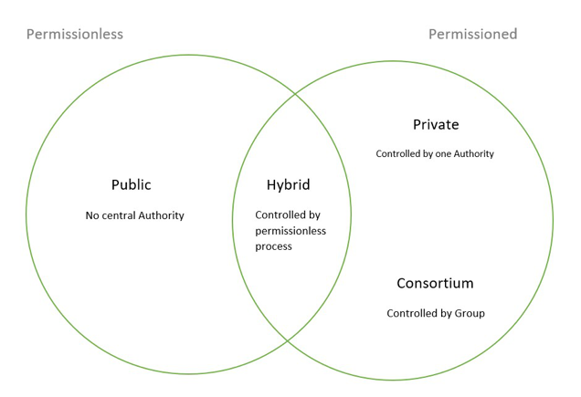

Slide 17
Architecture
Distributed Ledger:
Blockchain is like a distributed ledger.
Records transactions like purchases, sales, receipts, and payments.
Immutable and visible to everyone.
Transactions are blocks linked together, forming a chain.
Each block contains cryptographic identifiers of the previous block.
Cryptographic Hash Function:
Ensures the integrity of blockchain data.
Each block contains a unique cryptographic hash of the previous block.
Any alteration to a block is immediately apparent.
Consensus Mechanism:
Achieves agreement on the state of the blockchain and transaction validity.
Eliminates the need for a central authority.
Common mechanisms include Proof of Work (PoW) and Proof of Stake (PoS).
Proof of Work (PoW):
Validates transactions by solving mathematical puzzles.
Nodes compete to find the correct answer first.
Difficulty adjusts based on network size.
The first node to find the answer earns a block reward.
Proof of Stake (PoS):
Validators selected to validate transactions.
Energy-efficient alternative to PoW.
Reduces the need for extensive computational power.
Smart Contracts:
Self-executing contracts with terms written into code.
Automatically enforce agreement terms when predefined conditions are met.
Enhance transaction efficiency and security.
Reduce the need for intermediaries.

Slide 18
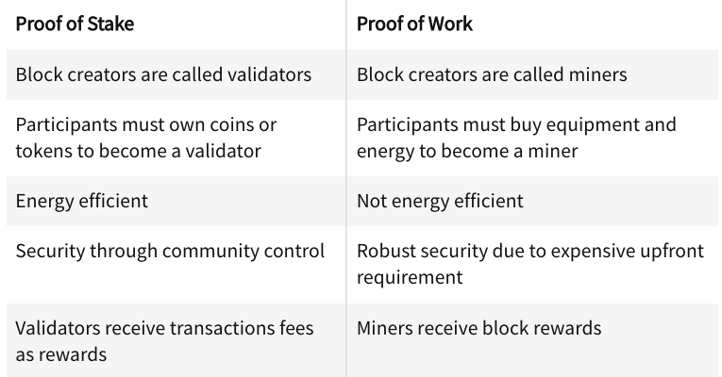

Slide 19
Data Structure
Block Headers:
Metadata to identify the block in the network.
Includes:
Previous Block Hash: SHA 256 hash of the previous block.
Merkle Root: Verifies block data integrity.
Timestamp: Creation time of the block.
Difficulty Target: Difficulty of the Proof-of-Work algorithm.
Nonce: Random number for mining process.
Block Height:
Identifies the position of the block in the blockchain.
Blocks with the same height may compete for the same position.
Genesis Block:
The first block in the blockchain.
Merkle Trees:
Hash tree where each node is labeled with the hash value of a block.
Typically binary and enables quick and secure content verification across the blockchain network.

Slide 20
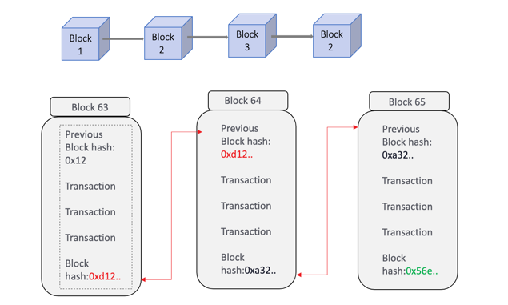

Slide 21
Hardware
Node Configuration:
A server configured to join the blockchain network for processing.
Minimum hardware requirements must be met.
Custom Solutions:
Participants can create custom hardware solutions to contribute to the blockchain network.
Virtual or Physical Nodes:
Nodes can be virtual machines or physical servers owned by participants.
Data Storage:
Nodes store partial or full copies of transactions across the network.
Compliance:
Nodes must comply with the algorithms and mechanisms of the blockchain network when added to the system.

Slide 22
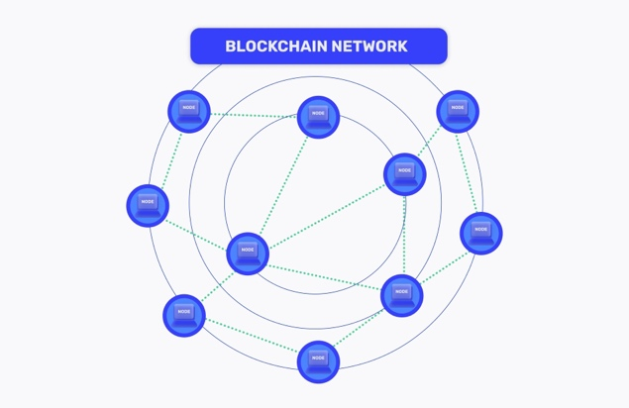

Slide 23
Blockchain Applications
Supply Chain Management:
Enhances transparency and traceability.
Ensures authenticity of goods and reduces fraud.
Financial Services:
Enables secure and transparent transactions.
Facilitates cross-border payments and digital asset management.
Healthcare:
Stores and manages patient records securely.
Enables interoperability among healthcare providers.
Voting Systems:
Creates secure and tamper-proof voting processes.
Enhances security and transparency in elections.
Identity Management:
Provides decentralized identity management.
Offers control over personal data and mitigates identity theft risks.
Intellectual Property Protection:
Manages and protects intellectual property rights securely.
Ensures transparency and authenticity in patent, trademark, and copyright management.

Slide 24
Attacks on Blockchain
51% Attack:
Occurs when a single entity controls over 50% of the mining power.
Enables manipulation of transaction history and double-spending.
Sybil Attack:
Involves creating multiple false identities to gain control over the network.
Can disrupt the consensus mechanism and manipulate transaction validation.
Eclipse Attack:
Aims to isolate specific nodes from the network by controlling their information.
Leads to data manipulation and disruption of network operation.
Denial of Service (DoS) Attack:
Disrupts network operation by overwhelming it with high traffic or transactions.
Causes network slowdowns, transaction delays, or complete unavailability.
Double Spend Attack:
Involves spending the same cryptocurrency more than once.
Exploits consensus mechanism vulnerabilities to fraudulently spend funds.

Slide 25
Fraudulent Activities on Blockchain
Pump-and-Dump Schemes:
Inflate cryptocurrency value through false statements, then sell off to unsuspecting investors.
Manipulate market prices, leading to financial losses for investors.
Phishing:
Trick users into revealing private keys or login credentials for cryptocurrency wallets and exchanges.
Enables unauthorized access to users' funds, leading to theft and fraudulent transactions.
Smart Contract Vulnerabilities:
Susceptible to flaws that can be exploited by fraudsters.
Examples include re-entrancy attacks, lack of input validation, and insecure programming languages.
Vulnerabilities can lead to unauthorized transactions and financial losses.
Insider Attacks:
Involve illegal trading of cryptocurrencies based on non-public information.
Undermine market fairness and integrity by providing unfair advantages to those with privileged information.
Ponzi Schemes:
Promise high returns with little or no risk to investors.
Use funds from new investors to pay returns to earlier investors, creating the illusion of profitability.
Collapse when new investors can no longer be recruited or existing investors demand their funds.

Slide 26

Ethereum

Slide 27
Ethereum
Overview:
Decentralized platform enabling developers to build and deploy smart contracts and decentralized applications (DApps).
Contrasts with Bitcoin as a programmable platform rather than solely a digital currency.
Smart Contracts:
Self-executing contracts with terms directly written into code.
Automatically enforce and execute agreement terms when predefined conditions are met.
Provides transparency and tamper-resistant automation of processes.
Ethereum's Native Cryptocurrency:
Ether (ETH) is Ethereum's native cryptocurrency.
Used to pay for transaction fees and computational services on the network.
Decentralized Autonomous Organizations (DAOs):
Organizations represented by rules encoded as computer programs.
Transparent, controlled by members, and can manage and distribute funds without centralized control.

Slide 28
Ethereum Virtual Machine (EVM)
Ethereum Virtual Machine (EVM):
Key component enabling execution of smart contracts and decentralized applications on Ethereum network.
Turing-complete virtual machine capable of performing any computation a conventional computer can.
Functionality of EVM:
Processes and executes smart contracts coded in high-level languages like Solidity.
Compiles smart contracts into bytecode for execution on the EVM.
Smart contracts autonomously execute predefined functions when triggered by specified conditions.
Role in Decentralized Applications (DApps):
Enables execution of DApps on Ethereum network.
DApps utilize EVM to execute code and interact with smart contracts.
Provides decentralized and transparent environment for various applications such as finance, gaming, and governance.

Slide 29
Gas & Transactions
Gas and Transactions:
Gas is used to measure computational effort on Ethereum network.
It is the unit for paying for operations performed on the Ethereum Virtual Machine (EVM).
Gas Usage:
Each operation on the EVM consumes a specific amount of gas.
Users pay for operations using Ether, Ethereum's native cryptocurrency.
Transaction Parameters:
Users specify gas limit and gas price when initiating transactions or deploying smart contracts.
Gas limit defines maximum amount of gas user is willing to consume.
Gas price determines cost per unit of gas.
Miner Compensation:
Miners process transactions and smart contract deployments.
They are compensated with gas fees paid by users for processing transactions and smart contracts.

Slide 30
Ecosystem
Ethereum Ecosystem:
Support for tokens has led to a vast ecosystem of digital assets and decentralized finance (DeFi) applications.
Decentralized Applications (DApps):
Ethereum platform facilitates the development of DApps operating on a peer-to-peer network.
DApps enable functionalities such as decentralized finance, gaming, marketplaces, and social networking on the blockchain.
Initial Coin Offerings (ICO):
Ethereum's smart contracts are utilized for creating and executing ICOs, a fundraising method for new cryptocurrencies or tokens.
ICOs have facilitated the launch of numerous blockchain projects and startups.
Stablecoins:
Ethereum infrastructure supports stablecoins, digital assets pegged to a stable value like fiat currency.
Stablecoins provide stability in the volatile cryptocurrency market and are widely used for trading and as a store of value.
Decentralized Finance (DeFi):
Ethereum is pivotal in the rise of DeFi, creating open and permissionless financial services accessible to anyone with internet connection.
DeFi protocols enable activities such as lending, borrowing, yield farming, and decentralized exchanges.
Impact and Innovation:
Ethereum's versatile ecosystem fosters innovation and reshapes the landscape of digital finance and decentralized applications.
From smart contracts and tokens to groundbreaking applications, Ethereum serves as a catalyst for blockchain technology advancement.
Future Potential:
Developers and entrepreneurs can pioneer transformative solutions across diverse industries by harnessing Ethereum's potential.
Its robust infrastructure and programmability make it an attractive platform for building next-generation decentralized applications.

Slide 31
Ethereum Account Type
Ethereum accounts are classified into two main types:
Externally Owned Accounts (EOA):
EOAs are controlled by private keys and operated by individuals.
They are used for initiating transactions, deploying smart contracts, and interacting with decentralized applications.
The control of an EOA lies entirely with the private key holder, ensuring a high level of personal control and security.
Contract Accounts (CA):
Contract Accounts are controlled by their code rather than a private key.
They are responsible for executing smart contracts and managing their state.
Contract Accounts are created when a smart contract is deployed on the Ethereum network.
The code within Contract Accounts defines rules, stores data, and interacts with other smart contracts and EOAs.
Distinct Roles:
EOAs serve as conduits for human interaction, while Contract Accounts facilitate the execution of automated processes and smart contracts.
Both account types contribute to the programmable nature of the Ethereum blockchain, enabling a wide range of decentralized applications and financial instruments.

Slide 32
Ethereum Token Types
Ethereum tokens come in different types, each serving specific purposes within the ecosystem.
Utility Tokens:
Utility tokens provide access to products or services within a particular platform.
They facilitate transactions and interactions within decentralized applications (DApps).
Utility tokens hold intrinsic value within the ecosystem and are used for accessing premium features, paying for services, or participating in governance mechanisms of DApps.
Security Tokens:
Security tokens represent ownership of real-world assets, such as equity in a company or debt.
They are subject to regulations and legal compliance and offer investors financial interests or dividends.
Smart contracts govern security tokens to ensure regulatory compliance and enable automated distribution of dividends or other financial instruments.
Non-Fungible Tokens (NFTs):
NFTs are unique digital assets that represent ownership or proof of authenticity of a specific item or piece of content.
They are indivisible and not interchangeable, making each NFT distinct and irreplaceable.
NFTs have applications in digital art, collectibles, virtual real estate, and in-game assets within the Ethereum ecosystem.
ERC-20 Tokens:
ERC-20 is a standard for fungible tokens on the Ethereum network.
These tokens are interchangeable and can be subdivided into smaller units.
ERC-20 tokens serve as the foundation for initial coin offerings, crowdfunding campaigns, and the creation of tokenized assets.
They adhere to predefined functions, ensuring interoperability and compatibility with Ethereum-based services and DApps.

Slide 33

Main Research

Slide 34
Cryptocurrency Fraud Detection
Farrugia et al. (2020) conducted significant research on detecting illicit activities on the Ethereum blockchain using machine learning.
They identified crucial features and patterns in Ethereum transactions indicative of illegal account activities.
Features included interaction and transaction values, node degree features, transaction amount variance, smart contract features, successful transactions, and illicit identification markers.
They curated a dataset comprising flagged accounts for illicit activities and achieved an average accuracy of 96.3% with an AUC of 0.994 using the XGBoost classifier.
Three features, namely the time interval between transactions, total Ether balance, and minimum value received, were highlighted as influential in the predictive model.
Farrugia et al.'s study offers a robust methodological framework and benchmark dataset for future research in financial security, setting a precedent for fraud detection on the Ethereum blockchain.

Slide 35
Metrics of XGBoost in n fold of cross validation (Farrugia et al., 2020).
# of Folds | Optimal Depth | Optimal # estimators | Accuracy | FI | AUC | Execution time (s)
3 | 4 | 300 | 0.960 (+-0.002) | 0.957 (+-0.002) | 0.993 (+-0.0005) | 62.03
4 | 4 | 200 | 0.960 (+-0.002) | 0.957 (+-0.002) | 0.993 (+-0.0003) | 91.13
5 | 3 | 250 | 0.962 (+-0.004) | 0.959 (+- 0.005) | 0.994 (+-0.0008) | 105.4
10 | 4 | 150 | 0.963 (+-0.006) | 0.960 (+- 0.006) | 0.994 (E 0.0007) | 230.6

Slide 36
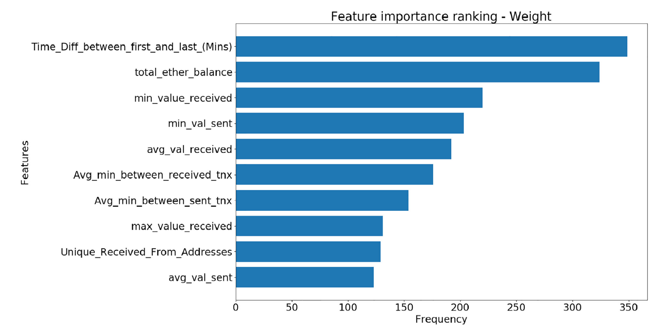
Feature Importance Ranking from the dataset (Farrugia et al., 2020)

Slide 37
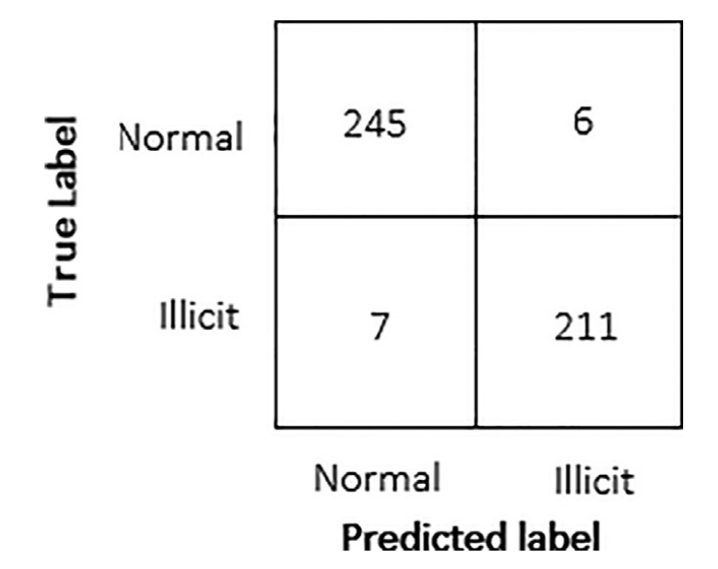
Confusion Matrix of Proposed XGBoost algorithm (Farrugia et al., 2020)

Slide 38
Pioneering Approach in Fraudulent Account Identification
Sallam et al. conducted research aimed at identifying fraudulent accounts on the Ethereum blockchain.
They employed machine learning techniques, including K-Nearest Neighbour, Random Forest, and XGBoost, on a dataset of 4,681 instances.
The XGBoost model achieved an average accuracy of 96.80% and an average AUC of 0.995, demonstrating high efficacy in fraud detection.
Results from Random Forest and K-Nearest Neighbour models also showed robust performance, with average accuracies of 94.88% and 87.85%, respectively.
Sallam et al.'s findings contribute to enhancing the safety and integrity of the Ethereum network, marking a significant advancement in blockchain security measures.
Their methodologies and outcomes offer valuable insights into the potential applicability of machine learning techniques for fraud detection in other blockchain environments.

Slide 39
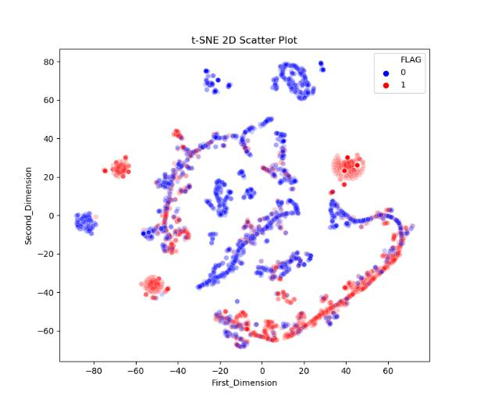
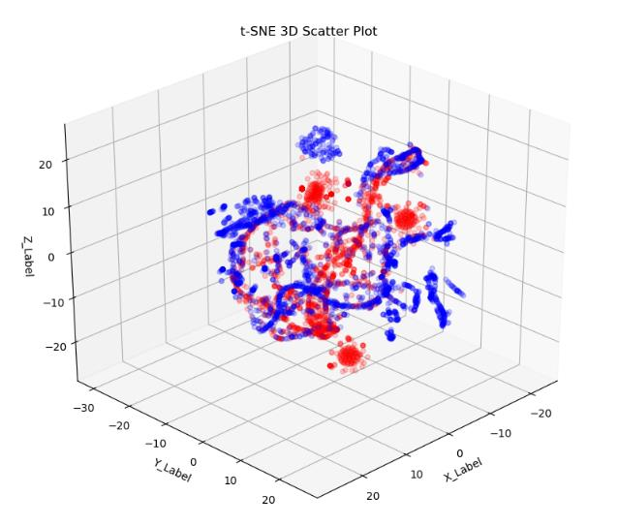
t-SNE Scatter Plots
2D t-SNE
3D
Sallam et al., 2022
Notes:
The figures above that shows different classes of Ethereum account, the researchers found that there are a few distinguishable clusters of blues and reds, but some clusters are not linearly possible. This signifies the importance of Machine Learning algorithms to find the significant features among account clusters.

Slide 40
Evaluation of the machine algorithm models
Sallam et al., 2022

Slide 41
Hyperparameters of machine learning algorithms
Sallam et al., 2022

Slide 42
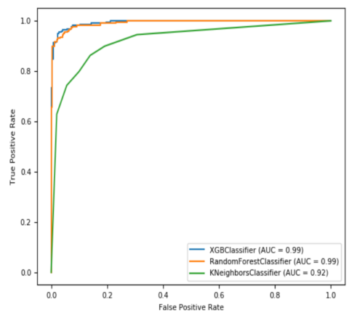
AUC performance of different machine algorithm models
Sallam et al., 2022

Slide 43
K-Nearest Neighbour and Supervised Machine Learning Models
K-nearest neighbour (KNN) is an unsupervised machine learning algorithm used for instance-based learning.
While simple and intuitive, KNN may be sensitive to irrelevant features and computationally costly for large datasets.
Studies by Farrugia et al. (2020) and Sallam et al. (2022) showcased the effectiveness of supervised machine learning models like XGBoost, Random Forest, and MLP for fraud detection on the Ethereum blockchain.
Hyperparameter tuning, feature importance ranking, and cross-validation are essential steps in model preparation and evaluation.

Slide 44
Recent Advances in Fraud Detection Research
Norouzi (2023) introduced a novel feature selection method for fraud detection on Ethereum using Random Forest.
Norouzi's study emphasized the exceptional performance of the Random Forest model, achieving an average AUC score of 0.998.
Taher et al. (2024) focused on ensemble learning techniques for detecting fraudulent transactions on the Ethereum network.
Their approach showcased a 99% accuracy rate using a hard voting ensemble model, which combined predictions from multiple machine learning models.
Both studies provide valuable insights into fraudulent account behaviour and contribute to the ongoing discourse on blockchain security.

Slide 45
Performance of Machine Learning Models in Detecting Fraudulent Accounts on Ethereum
Norouzi, 2023

Slide 46
Ethereum Fraud Detection Algorithms Results
PREC = Precision, REC = Recall, ACC = Accuracy F-S = F1 Score
Taher et al., 2024

Slide 47
Comparative analysis between proposed and other researchers in terms of accuracy
Reference | ACC
Proposed | 99%
Farrugia et al., 2020 | 96.30%
Bhowmik et al., 2021 | 98%
Y. Elmougy, 2021 | 80.20%
Kabla et al., 2022 | 98.11%
Amponsah et al., 2022 | 97.96%
Taher et al., 2024

Slide 48
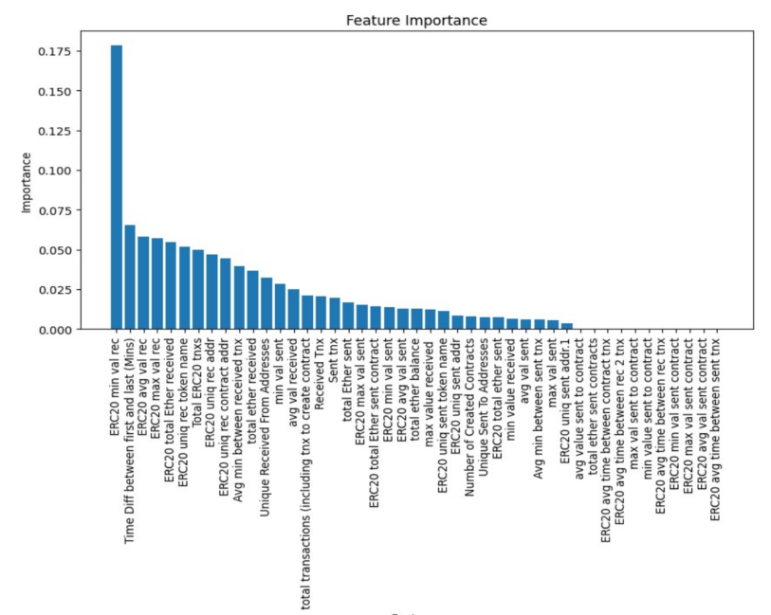
Feature importance rankings utilizing the RF classifier
Taher et al., 2024

Slide 49
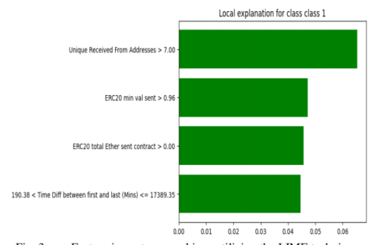
Feature importance ranking utilizing LIME technique
Taher et al., 2024

Slide 50
Key Considerations for Future Research
Data scientists can replicate and extend previous research by considering essential steps like data cleaning, balancing, and hyperparameter tuning.
Clustering using t-SNE visualization, feature importance ranking, and cross-validation are crucial for understanding and evaluating model performance.
Access to researchers' repositories for data and code transparency ensures reproducibility and facilitates further research in blockchain security.
Performance metrics, hyperparameters, and visualizations serve as benchmarks for comparing model performance under the same conditions.

Slide 51
Similar Research

Slide 52
Comparative Study on Fraud Detection:
Research by Raghavan & Gayar (2019) conducted a comparative study on fraud detection algorithms using a dataset from the UCSD-FICO competition.
The dataset comprised 100,000 credit card transactions with 20 attributes from an e-commerce website.
Various machine learning and deep learning techniques were applied to detect fraudulent transactions.
Evaluation Metrics:
Performance evaluation was based on metrics such as Area Under the ROC Curve (AUC) and Matthews Correlation Coefficient (MCC).
Results:
All machine learning and deep learning techniques demonstrated high accuracy in detecting fraudulent transactions, ranging from 95% to 99%.
Implications for Blockchain Security:
While conducted on a different dataset, these findings highlight the effectiveness of machine learning algorithms in fraud detection.
The results provide insights into the potential applicability of similar techniques in detecting fraudulent activities on the Ethereum blockchain.
Continuation of Research:
Building on these findings, the proposed model can be applied to the Ethereum dataset to further validate its effectiveness in detecting illicit activities.
By leveraging insights from comparative studies, the research aims to contribute to the ongoing efforts in blockchain security and fraud detection.

Slide 53
MCC and AUC of European Dataset
Raghavan & Gayar, 2019

Slide 54
MCC and AUC of Australian Dataset
Raghavan & Gayar, 2019

Slide 55
MCC and AUC of German Dataset
Raghavan & Gayar, 2019

Slide 56
Top Performing Models
Raghavan & Gayar, 2019

Slide 57
Support Vector Machine (SVM) in Fraud Detection
SVM is a machine learning algorithm used for classification and regression analysis.
It separates data points by maximizing the distance of a hyperplane at the origin.
Variants of SVM include One-class SVMs, C-Support SVMs, Nu-Support SVMs, and epsilon-Support SVMs.
Researchers have proposed combining One-class SVM with K-Means algorithm to enhance fraud detection in blockchain transactions.
One-class SVMs capture regions of the input space and the probability density of the data within these regions.

Slide 58
Performance of SVM in Fraud Detection
SVM, along with CNN and KNN, ranks among the top-performing models for fraud detection.
In Bitcoin theft detection, SVM is effective in detecting anomalous transactions while minimizing false positives.

Slide 59
Combination with Other Techniques
The combination of RIPPER (a data mining technique) and Gradient Boosting (an Ensemble Learning model) provides reliable results in fraud detection.
RIPPER analyzes patterns in the data and identifies anomalies or outliers indicating fraudulent activity.

Slide 60
Implications for Fraud Detection
SVM and its variants, along with Ensemble Learning techniques, demonstrate effectiveness in detecting fraudulent activities.
These approaches contribute to improving fraud detection systems' reliability and coverage, particularly in blockchain transactions and Bitcoin theft detection.

Slide 61
Future Research Directions
Continued exploration of SVM variants and their combinations with other algorithms can further enhance fraud detection capabilities.
Investigating the application of these techniques in other domains beyond blockchain and cryptocurrency can provide valuable insights into fraud detection methodologies.

Slide 62
RIPPER with Gradient Boosting, Bagging and Stacking
Hoang Khang et al., 2023

Slide 63
Effectiveness of RIPPER Algorithm
RIPPER algorithm is extensively studied compared to Bayes Network and Random Forest for detecting Bitcoin Ponzi schemes.
Achieved a true positive rate of 80% and a false positive rate of 5.6% in detecting Ponzi schemes with an imbalanced classification task (fraud: non-fraud ratio of 20:80).
Considered a good classifier for imbalanced classification tasks but slightly less effective than Random Forest according to the study by Bartoletti et al. (2018).

Slide 64
Performance in Unlabelled Datasets
In unlabelled datasets like the Bitcoin network, RIPPER exhibited near-perfect results in separating global and local outliers compared to K-means and kd-tree algorithms.
Random Forest was also used in detecting Ponzi schemes on Bitcoin and showed effectiveness, especially when considering different sampling techniques and algorithms.

Slide 65
Evaluation of Random Forest
Random Forest demonstrated a recall rate of 59.4% in detecting Ponzi schemes.
Despite this, it was considered the best-performing algorithm due to its application of sample-based and cost-effective approaches.
A cost matrix was built to assign different costs for different types of misclassifications, emphasizing the correct identification of Ponzi schemes as paramount. Random Forest correctly identified the majority of cases in the study by Bartoletti et al. (2018).

Slide 66
Conclusion
RIPPER algorithm shows promise in detecting Bitcoin Ponzi schemes, although Random Forest is slightly more effective according to Bartoletti et al. (2018).
Both algorithms offer valuable insights into fraud detection methodologies, particularly in the context of blockchain and cryptocurrency transactions.

Slide 67
Model Performance between RIPPER, Bayes Network and Random Forest with Cost Matrix of 20
Hoang Khang et al., 2023

Slide 68
Model Comparison with highly imbalanced Ethereum Blockchain Dataset
Random Forest for Fraud Detection on Ethereum:
Effective in identifying fraudulent transactions within Ethereum datasets.
Reveals common characteristics of Ponzi schemes (W. Chen et al., 2018).
Suitable for datasets with highly imbalanced class distributions, such as the Ethereum blockchain from Etherscan.io (Ostapowicz & Żbikowski, 2019).
Performance Metrics in Fraud Detection:
Achieved high accuracy of 98.5% and precision ranging from 75% to 100%.
Segregated 28 different categories of illicit users with high recall rates ranging from 0.50 to 1.00 and F1 scores ranging from 0.60 to 1.00 (Nerurkar et al., 2021).
Empirical Evaluation of Machine Learning Techniques:
Bhowmik et al. (2021) conducted an empirical evaluation of various supervised machine learning techniques for detecting fraudulent transactions within blockchain networks.
This research contributes to understanding the effectiveness of different machine learning models in fraud detection, which is crucial in the evolving technological landscape of blockchain technology.

Slide 69
Deep Neural Networks (DNN)
Type of ANN with multiple hidden layers.
Less accurate than traditional machine learning models, with a 94% accuracy metric (Bhowmik et al., 2021).

Slide 70
Accuracy of Logistic Regression, Multi-Layer Perceptron (MLP), Naïve Bayes, AdaBoost, Decision Tree, SVM, Random Forest, Deep Neural Network (DNN)
Bhowmik et al., 2021

Slide 71
Comparative Analysis of Machine Learning Algorithms
Researchers compare Support Vector Machines, Decision Trees, Naive Bayes, Logistic Regression, and others.
Random Forest emerges as the top-performing algorithm, followed by SVM and AdaBoost (Bhowmik et al., 2021).

Slide 72
Artificial Neural Networks (ANN)
Subset of machine learning models inspired by the human brain's structure and functionality.
Versatile and effective for tasks such as image recognition, natural language processing, and prediction.
In supply chain studies, ANN achieves a high accuracy level of 97%, outperforming XGBoost (Gu et al., 2023).

Slide 73
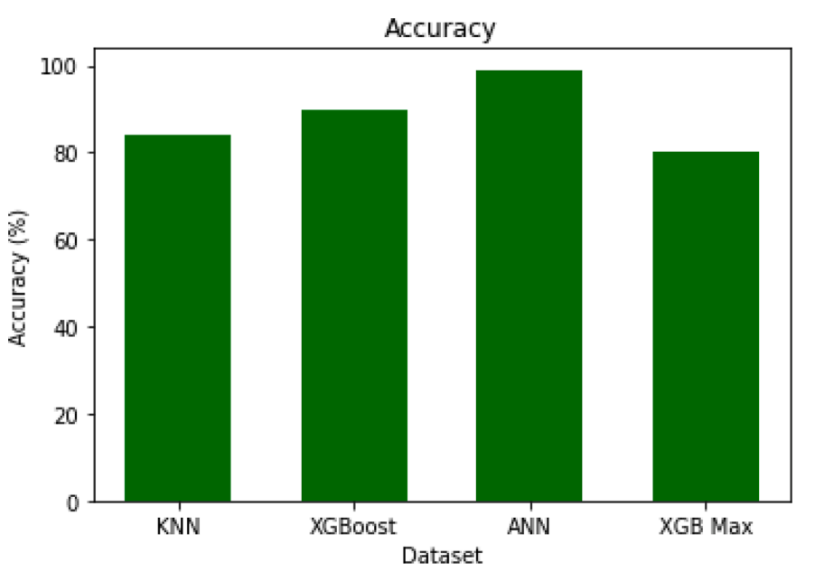
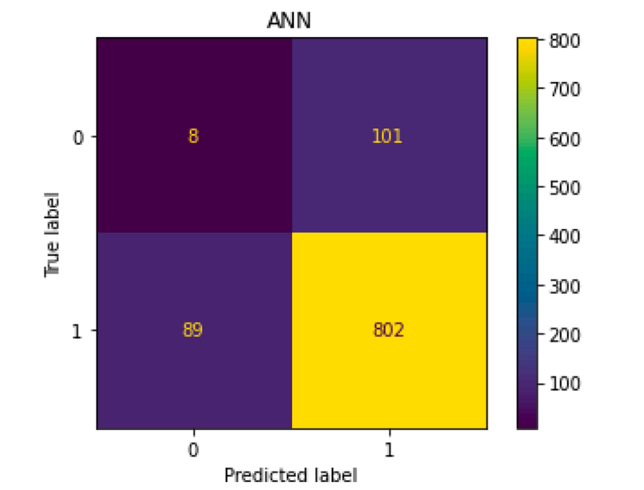
Accuracy Plot
ANN Confusion Matrix
Gu et al., 2023

Slide 74
Convolutional Neural Networks (CNN)
Widely used for image and video recognition tasks.
Excel in tasks such as object recognition, image classification, and image segmentation.
Graph Convolutional Network (GCN), a variant of CNN, performs well in detecting phishing scams in Ethereum transaction networks (L. Chen et al., 2021).

Slide 75
Long Short-Term Memory (LSTM) Networks
A type of Recurrent Neural Network (RNN) suitable for sequential datasets.
Effective for classifying fraudulent schemes in Ethereum transactions (Sankar Roy et al., 2022).

Slide 76
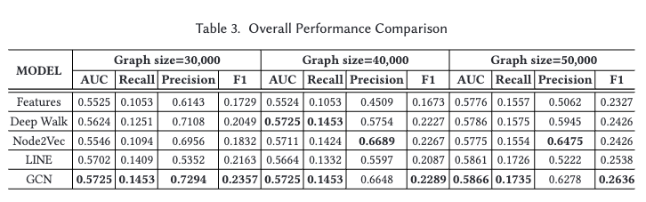
Model Performance Comparison between GCN, DeepWalk, Node2Vec and LINE for detecting phishing accounts in Ethereum Transaction Network
L. Chen et al., 2021

Slide 77
Result of LGBM, Ensemble Model, GBM, XGBoost and RNN with LTSM (Proposed)
Sankar Roy et al., 2022
Notes:
With the results above, the researcher claimed that proposed model is very performant in deep learning algorithms for classifying fraudulent schemes (Sankar Roy et al., 2022).

Slide 78
Summary
Algorithm Preference:
XGBoost, Random Forest, and SVM are frequently used and referenced as benchmarks in anomaly and fraud detection studies.
Decision Trees are utilized within ensemble learning methods like XGBoost and Random Forest but are not standalone choices due to limitations.
Dataset Usage:
Ethereum and Bitcoin datasets are commonly used for algorithmic experiments and model building in blockchain network research.
Supervised Learning Preference:
Supervised learning methods are favored over unsupervised learning due to superior performance across various metrics.
Evaluation Metrics Challenges:
Inconsistent evaluation metrics across studies make direct performance comparison challenging.
XGBoost emerges as a top choice due to efficiency and consistent performance in fraud detection across different datasets and experiments.
Machine Learning Algorithm Selection:
XGBoost is selected as the primary algorithm for model building based on its efficiency and proven performance in fraud detection in both Bitcoin and Ethereum transactions.
Exploration of Neural Networks:
Artificial Neural Network (ANN) models, including RNN, CNN, and DNN, have been tested by researchers but are yet to be explored on the dataset from Farrugia et al. (2020).
Some studies suggest that neural networks, especially CNN and GCN, show promise for detecting phishing accounts on the Ethereum network.
Deep Learning Potential:
Although traditional machine learning algorithms perform well, deep learning neural networks have an advantage in handling larger and more complex datasets, potentially leading to improved accuracy.

Slide 79
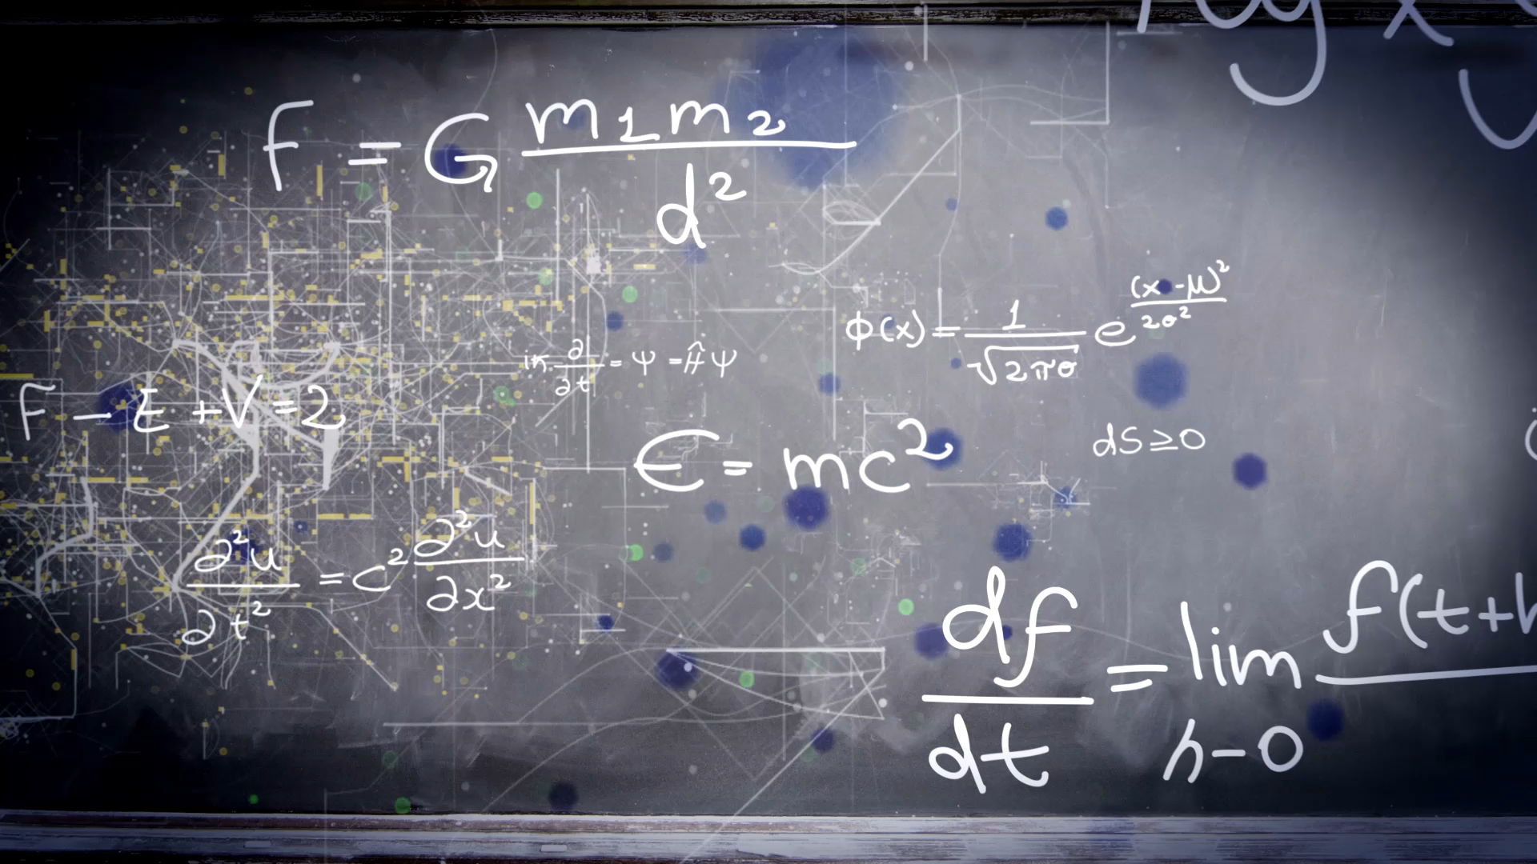
PROJECT METHODOLOGY

Slide 80
CRISP-DM
CRISP-DM Framework:
Structured Approach: CRISP-DM provides a systematic framework consisting of six phases: Business Understanding, Data Understanding, Data Preparation, Modelling, Evaluation, and Deployment.
Adaptability: The methodology is flexible and can be tailored to handle the complexities of fraud detection in blockchain transactions.
Advantages of CRISP-DM:
Handling Complexity: Suited for dealing with large and complex datasets, incorporating various machine learning techniques, and addressing specific challenges related to anomaly detection.
Emphasis on Data Pre-processing: Focuses on data pre-processing and feature engineering, critical for extracting meaningful insights from blockchain transaction data.
Iterative Model Development: Promotes an iterative approach to model development and evaluation, allowing for continuous refinement and optimization of fraud detection models.
Structured and Systematic Approach:
Ensures each phase of the project is properly executed, leading to a comprehensive and reliable fraud detection solution.
Flexibility for Complex Projects:
Adaptable to handle intricacies of fraud detection in blockchain transactions, ensuring all relevant aspects are considered and effectively addressed.
Emphasis on Data Pre-processing and Feature Engineering:
Critical steps in fraud detection, particularly in extracting meaningful insights from the unique characteristics of blockchain transactions.
Iterative Model Development and Evaluation:
Facilitates continuous feedback and improvement of models, enhancing their performance over time in identifying and classifying fraudulent transactions.
Notes:
Cross-Industry Standard Process for Data Mining (CRISP-DM).

Slide 81
Resources
Hardware
CPU: Intel i7-14700K (20 cores, 28 threads)
RAM: 128 Gigabytes of DDR4
GPU: Nvidia RTX4080 Super, 16 GB GDDR6 VRAM
Software
Base Environment: Python 3.9.19
IDE: JetBrains PyCharm 2024.1
Version Control Software: Git with GitHub
Dependencies:
Keras
TensorFlow
Scikit Learn (sklearn)
Imbalanced Learn (imblearn)
Jupyter Notebook (Jupyter)
CUDA
Transformers
XGBoost
Matplotlib
Seaborn
Sweetviz
Pandas
SciPy
Pandas
Streamlit

Slide 82
Procedures
3.2.1 Business Understanding
Understand the context of blockchain technology.
Scope out implementations of blockchain technology and their applications.
Conduct literature reviews to comprehend existing research in fraud detection within financial transactions, including database-based and blockchain-based approaches.
Make a research project proposal to justify the need for the study.
3.2.2 Data Understanding
Source the dataset identified through literature review.
Understand the chosen dataset, including its scope, features, and target variable.
Verify data integrity and quality.
Ensure alignment of dataset implementation with literature review findings.
3.2.3 Data Preparation
Load the dataset and explore its features and distributions.
Clean the data, perform feature engineering, imputation, and balancing.
Justify data transformations to ensure high-quality input for modeling.

Slide 83
Procedures
3.2.4 Modeling
Generate models using various techniques identified in the literature review.
Incorporate hyperparameters and perform grid search with multiple fold cross-validation.
Ensure integrity of model performance based on existing research.
3.2.5 Evaluation
Evaluate model performance using metrics such as confusion matrix, accuracy, precision, recall, F1 score, and AUC-ROC score.
Review the modeling process and results.
3.2.6 Deployment Visualization
Deploy the built models.
Visualize the performance of the final model(s) and provide analysis and findings.
Create tables with performance metrics for benchmarking and validation.
3.2.7 Documentation & Submission
Organize final documentation of the project stages.
Prepare formal documentation and presentations to share the results.
Provide avenues for further contributions and research based on the documented findings.

Slide 84
Dataset
The dataset used in this project was acquired from the following GitHub repository: GitHub - Ethereum Fraud Detection Dataset.
Data collection involved several steps, including obtaining API keys from EtherscamDB and Etherscan websites, establishing connections to a Neo4j database, retrieving illicit account addresses, identifying illicit transactions, retrieving normal account addresses, interacting with the Etherscan API, calculating account balances, retrieving transaction data, and computing statistics.
The target value in the dataset is based on Ethereum accounts flagged for illicit activities, including imitating other contract addresses, scam lotteries, fake ICOs, phishing, Ponzi schemes, and more.
Features in the dataset include interaction and transaction values, node degrees features, transaction amount variance, smart contract features, successful transactions, and illicit identification markers.
The original dataset was provided in CSV file format and contains 2179 illicit accounts and 2502 normal accounts, resulting in a total of 4681 observations.
The dataset consists of 43 features for each address, excluding the index and FLAG fields.

Slide 85
Dataset
The dataset includes various features related to Ethereum transactions and account activities.
Features provide information such as transaction values, node degrees, transaction amount variance, smart contract indicators, and more.
Each feature contributes to understanding the behavior and characteristics of illicit and normal accounts within the Ethereum network.
Understanding the dataset's features is crucial for data preprocessing, model building, and analysis.

Slide 86
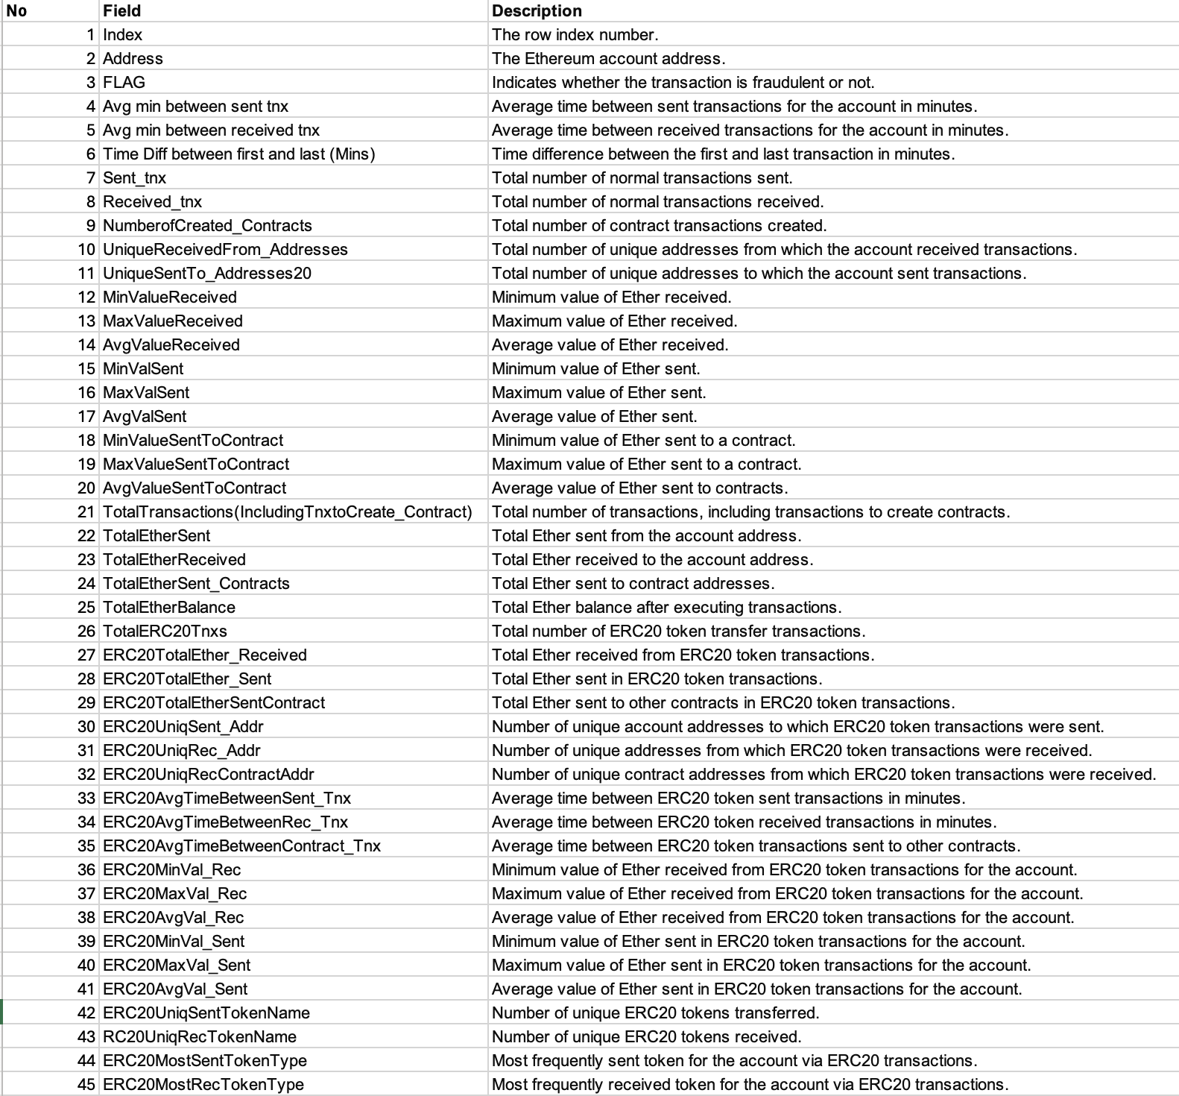
Features of dataset with Description

Slide 87

Project Plan

Slide 88
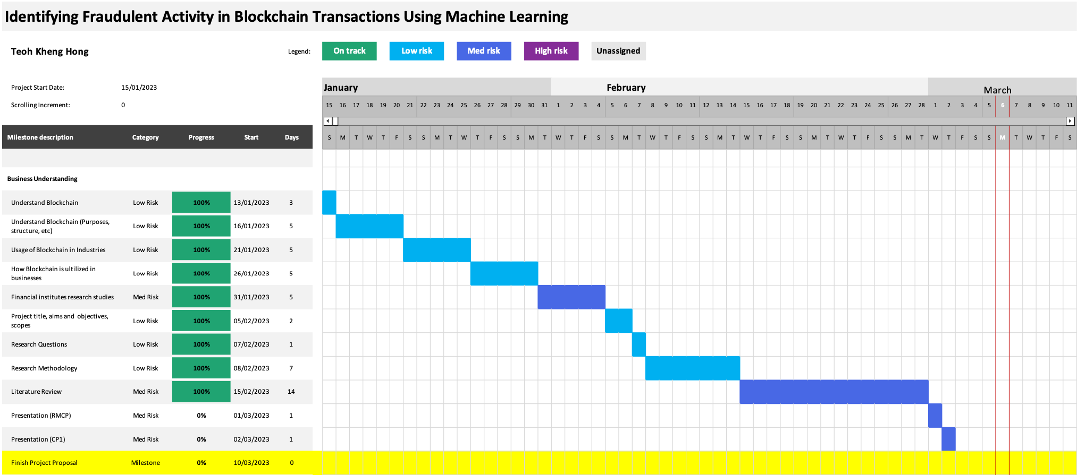
Stage 1

Slide 89
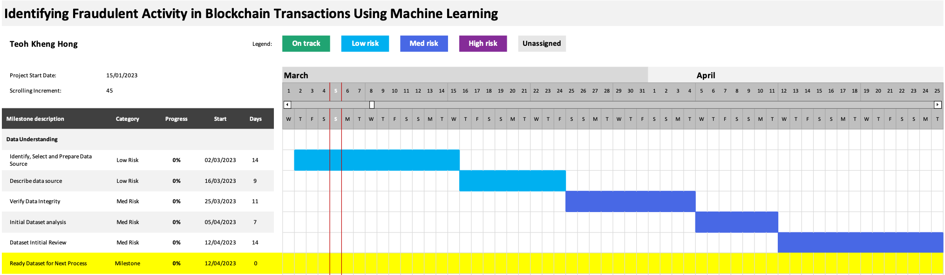
Stage 2

Slide 90
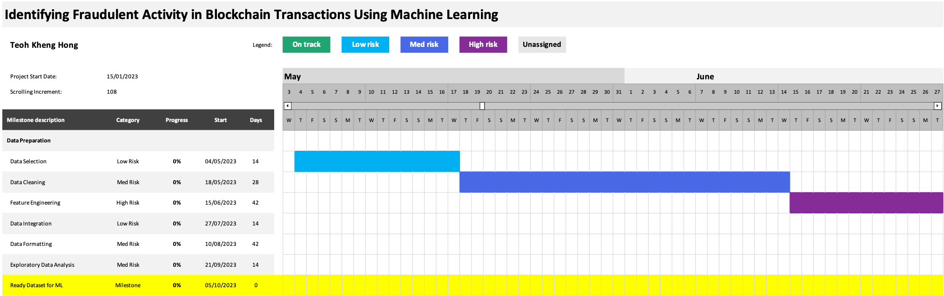
Stage 3

Slide 91
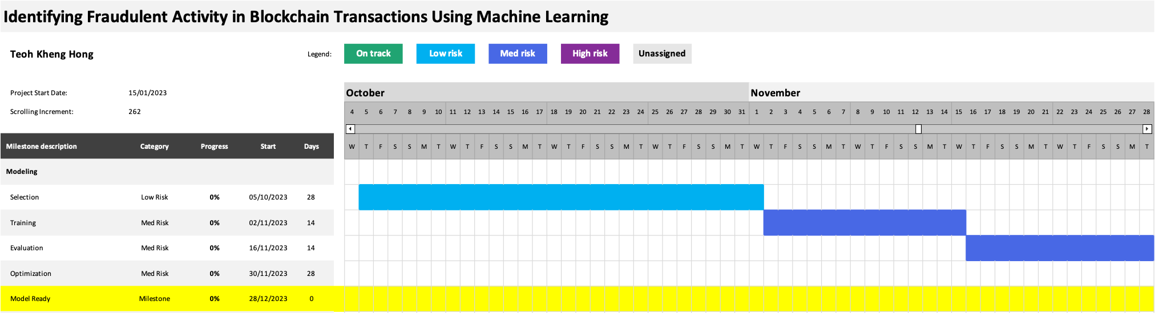
Stage 4

Slide 92
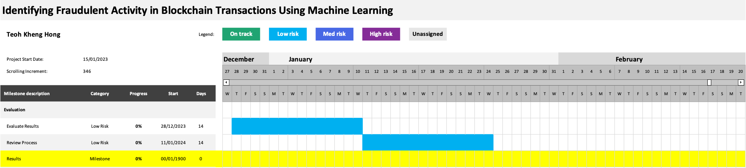
Stage 5

Slide 93
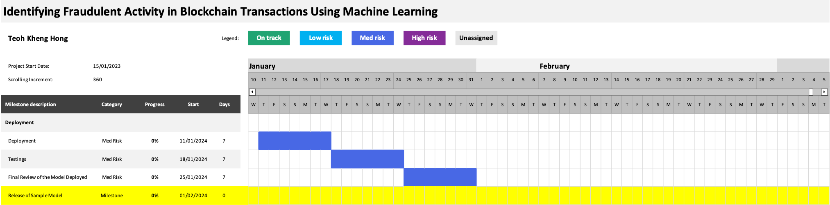
Stage 6

Slide 94
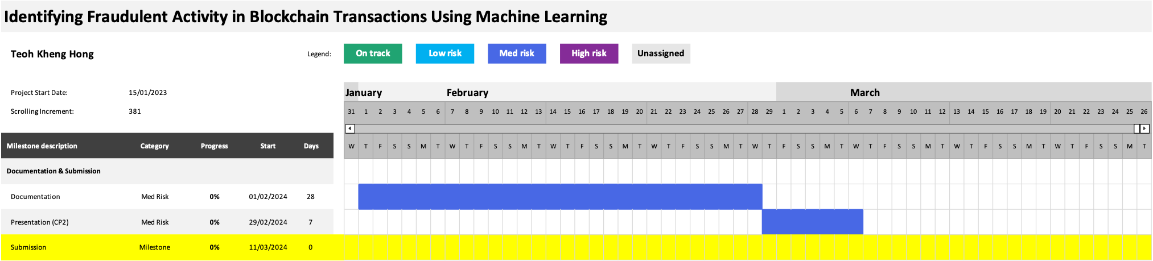
Stage 7

Slide 95

Implementation

Slide 96
Importing General Libraries
Importing General Libraries: Necessary libraries such as pandas, matplotlib, numpy, and seaborn are imported for data manipulation, visualization, and analysis.
import pandas as pd
import matplotlib.pyplot as plt
import numpy as np
import seaborn as sns
import warnings
warnings.filterwarnings('ignore')

Slide 97
Loading Dataset
The dataset size is determined by counting the number of lines in the CSV file.
The dataset is loaded into a pandas DataFrame, and unnecessary columns like Index and Address are omitted.
filename = 'transaction_dataset.csv'
# Count dataset number of lines to inform the dataset size first
def count_dataset_rows(file_name):
fp = open(file_name,'r')
for line_count, line in enumerate(fp):
pass
df = pd.read_csv(filename, index_col=0)
print(df.shape)
df.head()
# Omit first two columns (Index)
df = df.iloc[:,1:]

Slide 98
Outputs
file_line_count for transaction_dataset.csv: 4681
(4681, 49)

Slide 99
Data Preprocessing
Information about the dataset, including data types and non-null counts, is displayed.
Categorical variables are converted to 'category' dtype for efficiency.
Descriptive statistics and variance of numerical features are examined.
The target distribution is visualized using a pie chart.
Correlation matrix and heatmap are generated to identify multicollinearity among features.

Slide 100
# Turn object variables into 'category' dtype for more computation efficiency
categories = df.select_dtypes('O').columns.astype('category')
df[categories]
# Inspect numerical
numericals = df.select_dtypes(include=['float','int']).columns
df[numericals].describe()
# Inspect features variance
df[numericals].var()

Slide 101
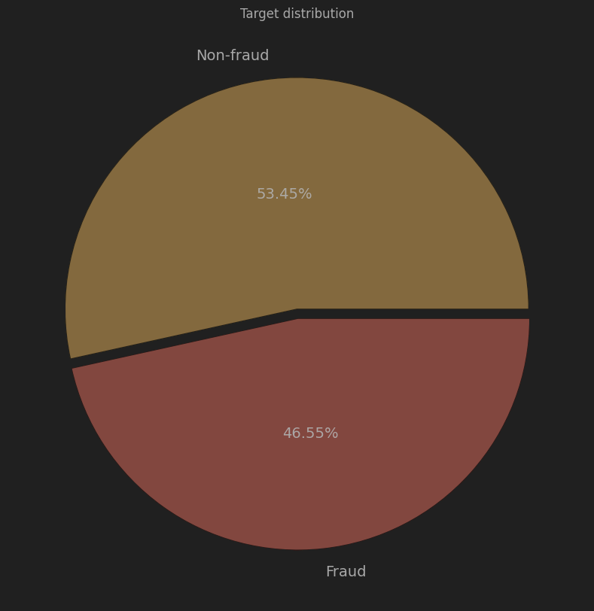
# Inspect target distribution
print(df['FLAG'].value_counts())
pie, ax = plt.subplots(figsize=[15,10])
labels = ['Non-fraud', 'Fraud']
colors = ['#f9ae35', '#f64e38']
plt.pie(x = df['FLAG'].value_counts(), autopct='%.2f%%', explode=[0.02]*2, labels=labels, pctdistance=0.5, textprops={'fontsize': 14}, colors = colors)
plt.title('Target distribution')
plt.show()
Outputs
FLAG
0 2502
1 2179

Slide 102
Data Cleaning
Missing values in numerical features are imputed with median values.
Features with zero variance, indicating no discriminatory power, are dropped from the dataset.
Remaining features are further analyzed for correlations, and highly correlated features are removed.
Data distribution is visualized using box plots to identify skewed distributions and outliers.
Features with small distributions are examined and discarded if they have minimal variability.
Finally, the dataset is prepared for the next stage, with unnecessary features removed.

Slide 103
Check Correlation for Collinearity
# Correlation matrix
corr = df.corr()
mask = np.zeros_like(corr)
mask[np.triu_indices_from(mask)]=True
with sns.axes_style('white'):
fig, ax = plt.subplots(figsize=(18,10))
sns.heatmap(corr, mask=mask, annot=False, cmap='CMRmap', center=0, square=True)

Slide 104
drop = ['total transactions (including tnx to create contract', 'total ether sent contracts', 'max val sent to contract', ' ERC20 avg val rec',
' ERC20 avg val rec',' ERC20 max val rec', ' ERC20 min val rec', ' ERC20 uniq rec contract addr', 'max val sent', ' ERC20 avg val sent',
' ERC20 min val sent', ' ERC20 max val sent', ' Total ERC20 tnxs', 'avg value sent to contract', 'Unique Sent To Addresses',
'Unique Received From Addresses', 'total ether received', ' ERC20 uniq sent token name', 'min value received', 'min val sent', ' ERC20 uniq rec addr' ]
df.drop(drop, axis=1, inplace=True)

Slide 105
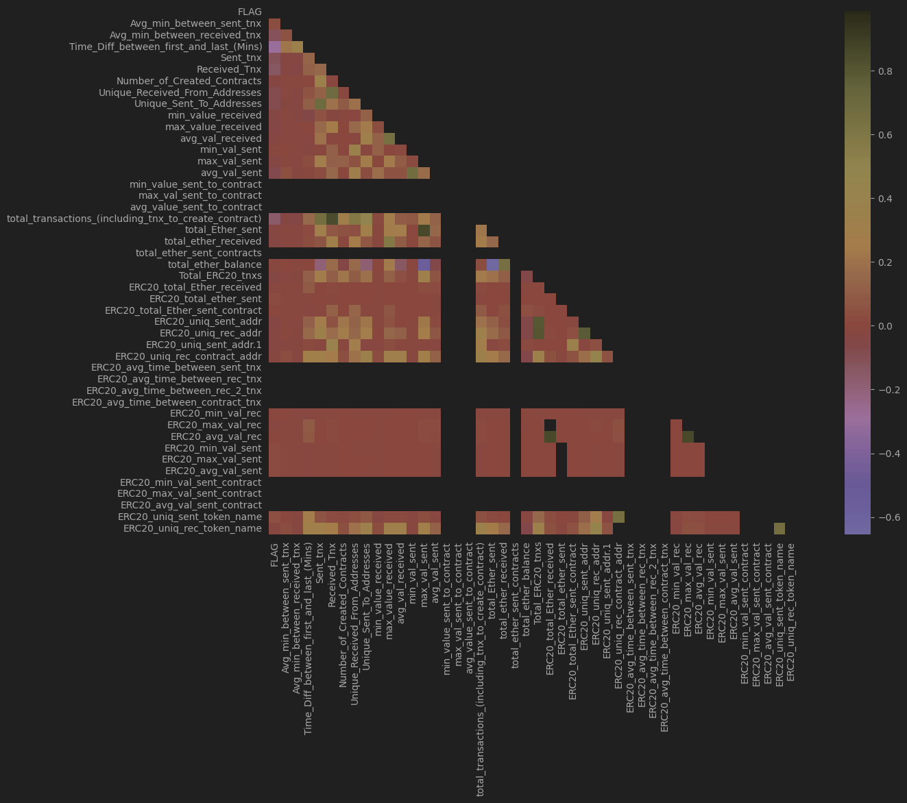
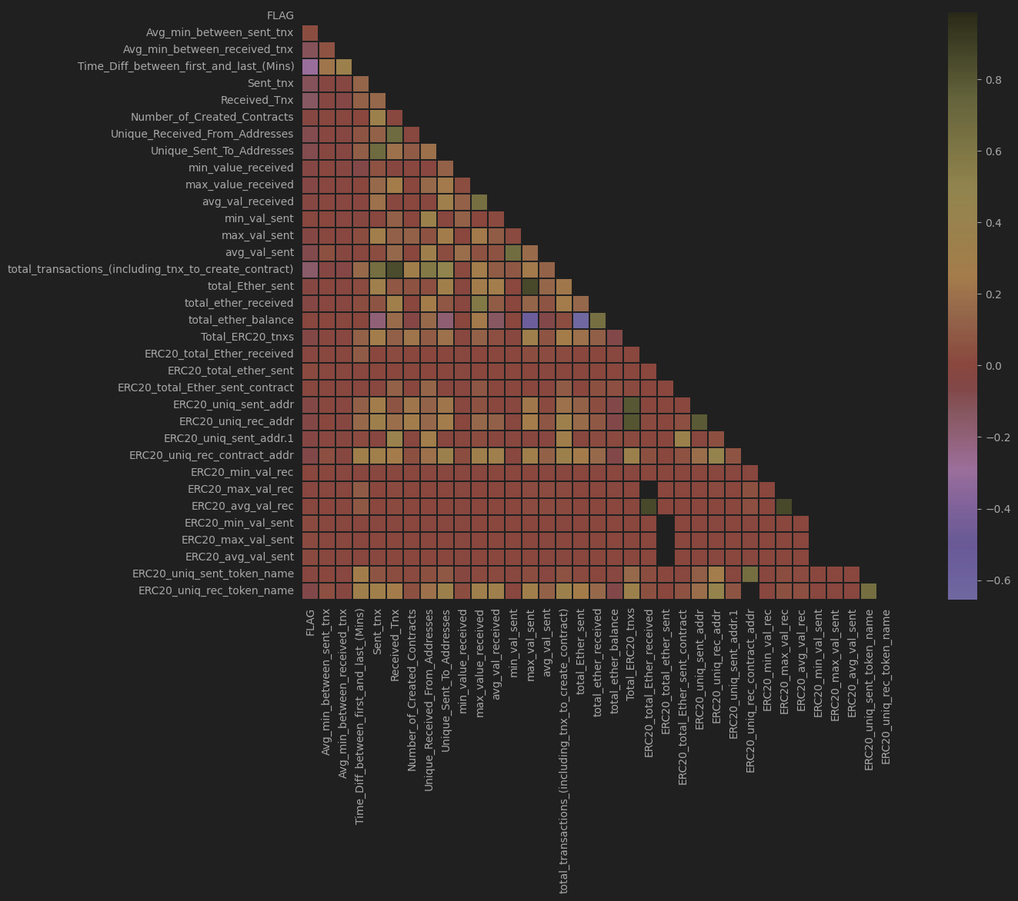
Before
After

Slide 106
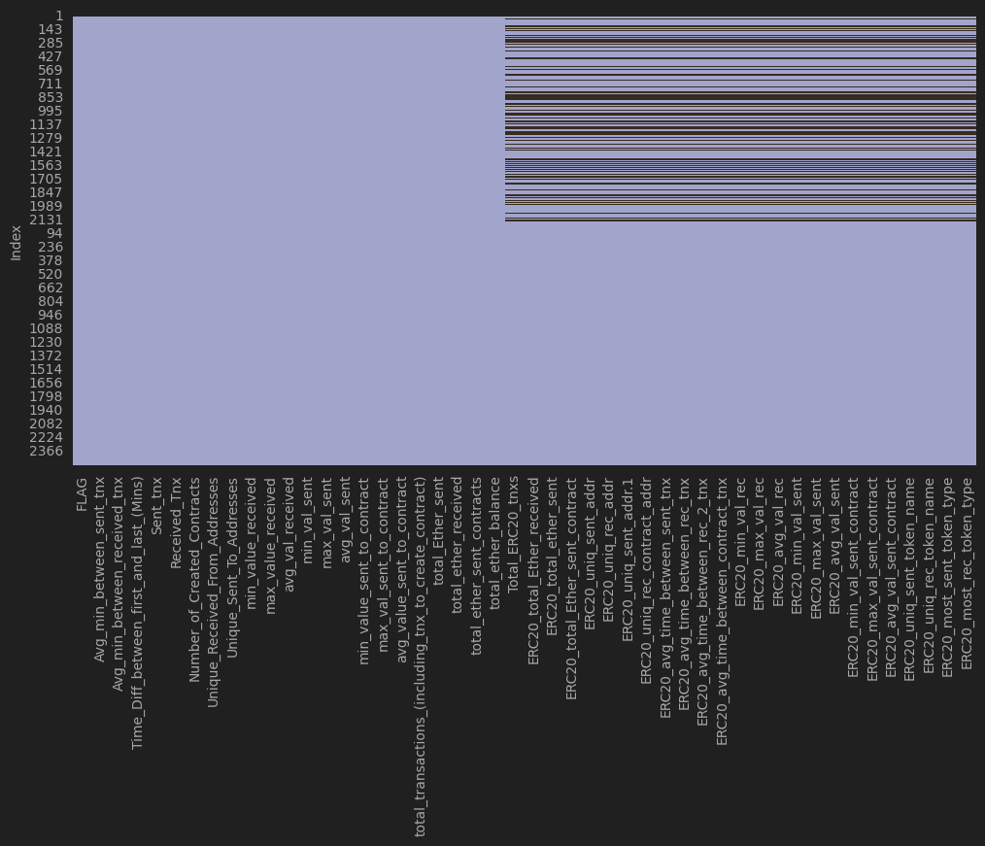
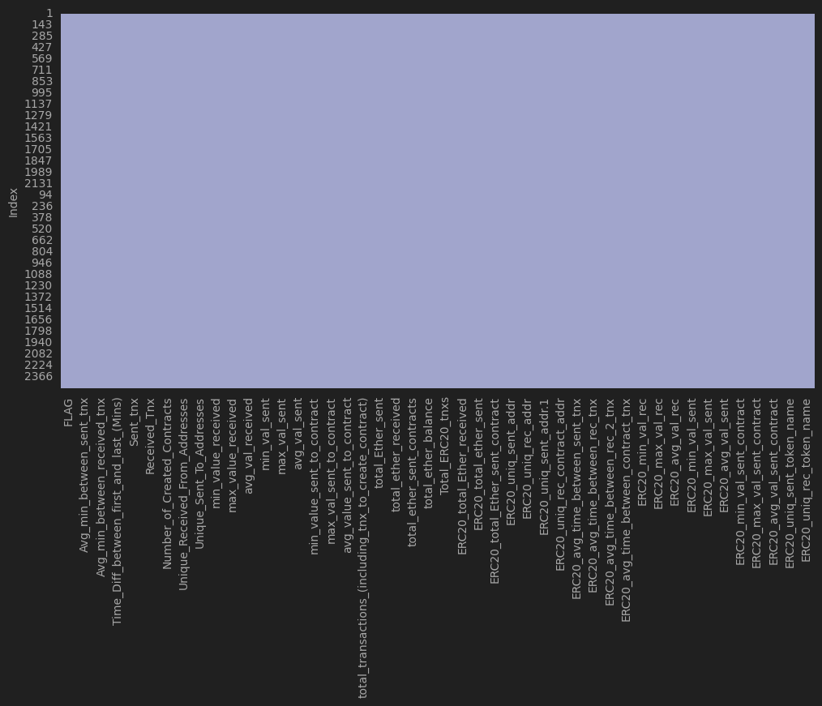
Before
After

Slide 107
Model Preparation
Data Splitting
Data Normalization
Data Balancing

Slide 108
Data Distribution
Box plots are used to visualize the distribution of features and identify outliers.
Features with minimal distribution variability are identified and removed from the dataset.

Slide 109
# Investigate the distribution of our features using box plots
fig, axes = plt.subplots(6, 3, figsize=(14, 14), constrained_layout=True)
plt.subplots_adjust(wspace=0.7, hspace=0.8)
plt.suptitle("Distribution of features", y=0.95, size=18, weight='bold')
for i, column in enumerate(columns[1:]):
row = i // 3
col = i % 3
ax = sns.boxplot(ax=axes[row, col], data=df, x=column)
ax.set_title(f'Distribution of {column}')
plt.show()

Slide 110
# Normalize the training features
norm = PowerTransformer()
norm_train_f = norm.fit_transform(X_train)
# Transform test features
norm_test_f = norm.transform(X_test)
norm_df = pd.DataFrame(norm_train_f, columns=X_train.columns)
norm_df

Slide 111
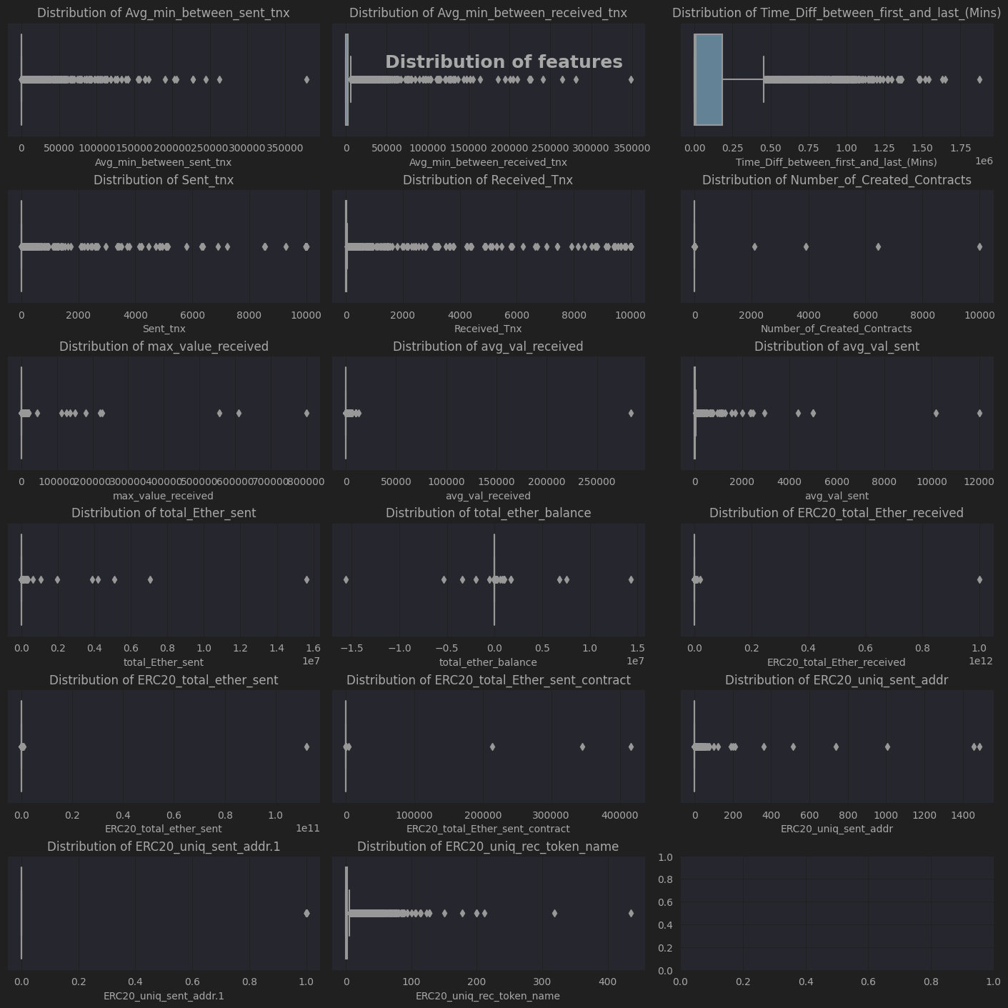
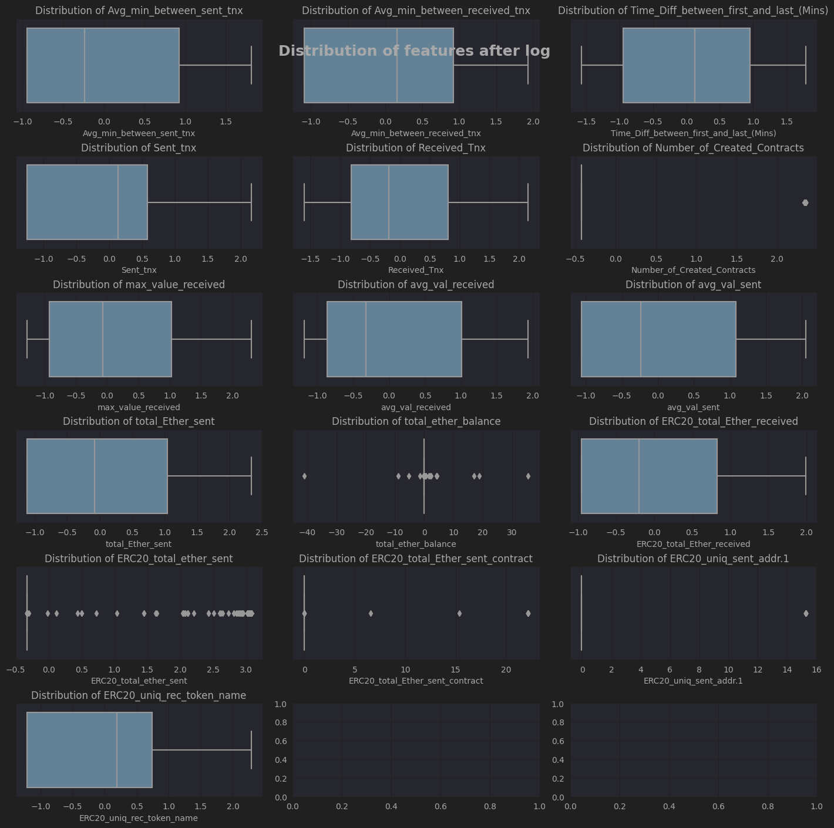
Before
After

Slide 112
Data Balancing
oversample = SMOTE()
print(f'Shape of the training before SMOTE: {norm_train_f.shape, y_train.shape}')
x_tr_resample, y_tr_resample = oversample.fit_resample(norm_train_f, y_train)
print(f'Shape of the training after SMOTE: {x_tr_resample.shape, y_tr_resample.shape}')

Slide 113
Shape of the training before SMOTE: ((3744, 16), (3744,))
Shape of the training after SMOTE: ((4018, 16), (4018,))

Slide 114

Modelling

Slide 115
Modelling
Utilizing existing techniques and literature reviews, a model building stage is initiated.
Grid Search Hyperparameters is introduced for automated and efficient hyperparameter tuning.
Reasons for using Grid Search Hyperparameters include automation, performance improvement, generalization, and efficiency.
GridSearchCV is employed for exhaustive hyperparameter search.
The process involves cross-validations on each hyperparameter combination, selecting those with the best performance.
Implemented Random Forest (RF), Support Vector Machines (SVM), Extreme Gradient Boosting (XGBoost), Deep Neural Network (DNN).
Model comparison Visualizations are made with DataFrame for comparison, can be exported to CSV for further analysis.

Slide 116
Deployment
Trained machine learning models have been deployed using Streamlit to showcase their application in a real-world scenario.
Implemented functions to export trained models, including logistic regression, support vector machine (SVM), and deep neural network (DNN).
Saved models in different formats such as pickle files for traditional models and JSON/H5 files for DNN models.
Each model was associated with specific parameters and performance metrics.

Slide 117
Developed a function to load trained models dynamically based on the selected model and fold.
Utilized pickle files for traditional models and JSON/H5 files for DNN models to load model architectures and weights separately.
Implemented a function for making predictions using the loaded models.

Slide 118
Created a Streamlit application titled "Machine Learning Model Deployment" for interactive model prediction.
Provided a dropdown menu to select the model and fold for prediction.
Enabled users to upload CSV files for which predictions are made.
Implemented preprocessing steps for DNN models before making predictions.
Displayed predictions generated by the selected model and uploaded data.

Slide 119
Users can interact with the Streamlit app by selecting different models and folds to observe predictions.
Uploaded CSV files are processed and used for making predictions, providing real-time insights into model performance.

Slide 120
Link
https://capstone-project-blsyvmwpznnrzqee9mvwh3.streamlit.app/

Slide 121
Results & Discussions

Slide 122
Logistic Regression

Slide 123
Random Forest

Slide 124
XGBoost

Slide 125
SVM

Slide 126
DNN

Slide 127
Key Findings
Logistic Regression:
Consistent metrics across different cross-validation folds (CV): accuracy, precision, recall, and F1 score.
High AUC-ROC score across all CV folds, indicating good overall classification ability.
Random Forest:
Achieves consistently high accuracy across different CV folds.
Balanced precision, recall, and F1 score, indicating effectiveness in identifying positive and negative instances.
Support Vector Machine (SVM):
Stable performance with consistent accuracy, precision, recall, and F1 score across different CV folds.
High AUC-ROC score, indicating good discriminatory power of the model.
Deep Neural Network (DNN):
Variance in performance across folds, with accuracy ranging from 93.6% to 95.4%.
High precision, recall, and F1 score, indicating effective classification ability.

Slide 128

DNN vs Logistic Regression
Logistic Regression achieves higher accuracy and precision compared to DNN in all CV folds.
DNN shows slightly higher recall values.
DNN may perform better in some respects compared to Logistic Regression in terms of recall, F1 scores, confusion matrix, and AUC-ROC score.

Slide 129
DNN vs Random Forest
Random Forest generally outperforms DNN across various metrics such as accuracy, precision, recall, and F1 score.
Higher accuracy, precision, recall, and F1 score for Random Forest compared to DNN.
Random Forest exhibits better performance in terms of true positives, true negatives, false positives, and false negatives.

Slide 130
DNN vs SVM
Competitive mean cross-validation accuracy scores between DNN and SVM.
SVM demonstrates slightly higher precision and F1 scores in most cases.
DNN tends to achieve slightly higher accuracy and recall values.

Slide 131
DNN vs XGBoost
XGBoost consistently demonstrates higher accuracy and precision compared to DNN across all folds.
DNN exhibits slightly higher recall values.
XGBoost consistently achieves higher AUC-ROC scores compared to DNN.

Slide 132

Conclusions

Slide 133
Conclusions
Blockchain Technology in Fraud Detection:
Blockchain technology has emerged as a critical tool in combating fraud in the finance industry.
Extensive efforts have been made to understand blockchain's potential in fraud detection, leading to ongoing research and development.
Challenges and Discoveries:
The complexity of blockchain transactions and the need for in-depth analysis pose challenges.
Data scientists have delved into feature engineering, visualization, and model implementation to address these challenges.
Feature Engineering and Model Implementation:
Extensive feature engineering, data cleaning, and balancing have been performed to compare machine learning models effectively.
Neural networks have shown promise in fraud detection, with the potential to outperform traditional algorithms.

Slide 134
Future Directions:
Further research is needed in fraud and anomaly detection, particularly in Anti-Money Laundering.
Trust within industries requires addressing concerns, developing robust models, and setting standards for financial transaction systems.
Model Performance and Improvement:
Deep Neural Networks (DNN) have demonstrated strong capabilities in detecting fraudulent transactions.
The model's hyperparameters are customizable, allowing for further optimization and improvement.
Implications and Future Research:
DNN's performance exceeds expectations and showcases its potential in fraud detection across various domains.
Future research will focus on optimizing the model and exploring its applicability in other areas beyond Ethereum blockchain transactions.

Slide 135

Thank you
Q&A session

